Slide 1



CSCE 606
Skhedule Project Presentation
Mohit Sarin
Erik Priest
Chong Wen
Shaunak Joshi
Ishant Kundra
Aashay Kadakia

Slide 2
Table of contents
01
02
03
Introduction
Design Choices
Challenges & Lessons

Slide 3


01
Introduction

Slide 4

Problem
Need for a Dedicated Platform
Our client needs a specialized scheduling platform for events with specific attendance requirements.
Inefficient Attendee Management:
Difficulties in managing attendee responses and preferences, leading to potential overbooking or underutilization of event capacity.
Inadequate Event Tracking
Events, especially those occurring in series, were challenging to track effectively, risking mismanagement and attendee dissatisfaction.

Slide 5


Introduction
Project Vision
Key Features
Revolutionizing event management with a seamless scheduling platform.
User-friendly interface for event coordinators and attendees, with options for single events and series, and direct CSV upload for attendee
Client Benefit
Project Goal
Custom-tailored to meet the specific needs of Southwest Innovation Research Lab (SwIRL) for efficient event organization.
To provide a streamlined, intuitive scheduling experience, reducing complexity and enhancing user engagement.

Slide 6


02
Design Choices

Slide 7
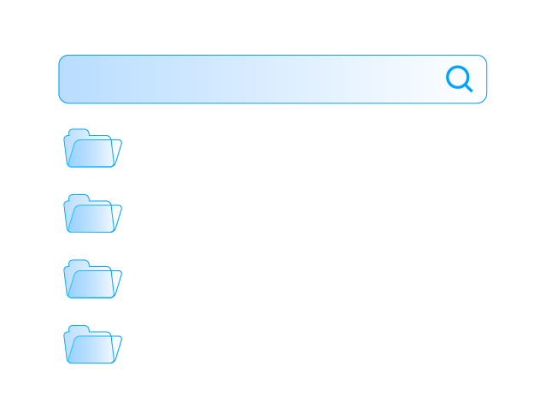

Database Design
Events Table
Event Infos
The core of our platform, tracking the essence of each event.
Detailed attributes of events, from descriptions to schedules, ensuring each event is unique and fully defined.
Attendee Infos
Time Slots
Attendee details and preferences, elevating the user experience with personalized management.
For series events, we accommodate multiple dates and times, making complex scheduling straightforward.

Slide 8
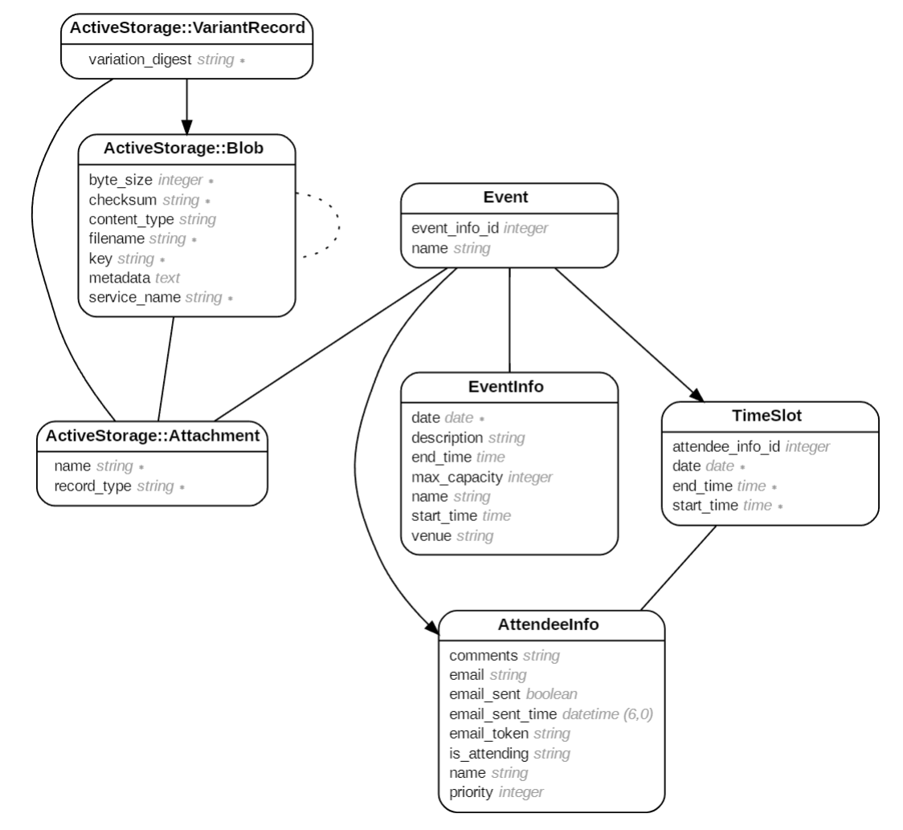
Database Design

Slide 9
Key Database Design Choices
Scalability
Efficient Attendee Management
A dedicated attendee_infos table streamlines RSVP tracking and attendee communication.
Separate tables for events, event_infos, and time_slots allow for easy expansion as the platform grows.
Maintainability
Flexibility
Modular design simplifies updates and maintenance, ensuring long-term stability and performance.
event_infos supports various event types, enabling detailed customization for both single events and series.

Slide 10
Events Controller
Efficient Data Handling
Bulk Attendee Management
Unique Attendee Identification
Streamlines event setup and management processes, ensuring ease of use and data accuracy.
Integration of bulk upload capabilities for attendee information, significantly reducing manual entry and enhancing efficiency.
Implements secure, automated generation of unique identifiers for each attendee, ensuring reliable tracking and response management.
Secure and Streamlined Processing
Flexible Event Scheduling
Automated Communication
Facilitates the creation and management of events with multiple time slots, essential for accommodating series events.
Includes functionalities to automatically send out reminders and invitations, improving engagement and attendance.
Adopts best practices in data handling and security, ensuring that event information is processed accurately and safely.

Slide 11

Efficient Email Communication System
Calendar Integration
Event-Specific Email Templates
For single events, includes iCalendar attachments, facilitating easy addition of events to personal calendars.
Tailors email content according to the type of event (single or series), enhancing relevance and clarity for recipients.
Bulk Email Sending
Reminders
Automates the process of sending invitations to multiple attendees, using CSV file uploads for efficiency.
Sends out timely event reminders, ensuring attendees are well-informed and engaged.

Slide 12
Event view pages
Dynamic Date-Time Entry
Interactive Collapsibles
Implement a JavaScript or jQuery-based dynamic form interface that allows users to add or remove date-time pairs seamlessly without reloading the page. This will improve the user experience by making the process of entering multiple date-time pairs for an event series more intuitive and efficient.
Utilize Bootstrap’s collapsible components for each event. This will make the user interface cleaner and more interactive, as users can click on an event header to reveal or hide the event details.
Dynamic Updating of Ratios
Implement JavaScript or AJAX to dynamically update the yes/no ratios without the need to refresh the page, providing a more responsive experience.
Dark Theme Elegance
Use a rich, deep black as the primary background color, creating an elegant and modern canvas. Subtly vary the shades of dark for different sections or elements like form fields and cards, adding depth and visual interest while maintaining the sophisticated, monochromatic scheme.
Form Validation Feedback
Provide immediate, inline validation feedback as the user fills out the form. For example, highlight input fields with a red border if the entered data is invalid, and display a checkmark or similar icon when the data is valid.

Slide 13

03
Challenges & Lessons

Slide 14
Challenges
Good Communication
Project Management
Maintaining clear and consistent communication across a team of six members.
Organizing tasks and managing time effectively across five iterations of development.
Ensuring Test Coverage and Quality
Understanding Client Needs
Attaining nearly complete code coverage with tests that not only fulfill a quota but also meaningfully validate the application's functionality, all while maintaining the pace of development.
Deciphering the actual requirements from client discussions and aligning them with our development capabilities within the given timeframes.

Slide 15
What we learned
Active listening and asking clarifying questions during meetings helped us grasp the client’s vision more accurately.
Regular demos and transparent dialogue kept the clients involved in the development process and ensured their feedback was promptly addressed.
Better using GitHub Projects to track progress and adapt to changes helped us stay on course and meet our deadlines.
Implementing a strict code review process and utilizing branching strategies on GitHub ensured high code quality and minimized conflicts.
Structured iteration reviews and retrospective meetings allowed us to learn from each cycle and continuously enhance our product.
Clear and mutual agreement on priorities for upcoming iterations ensured that the team’s focus was aligned with the most critical aspects of the project.

Slide 16

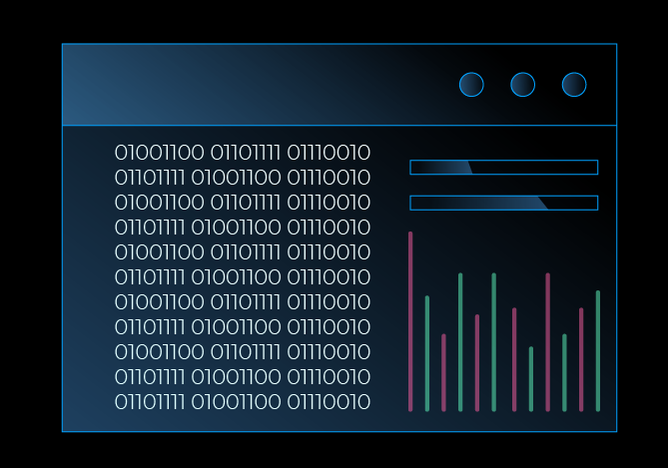
Thanks!

